Slide 1

Fake News Prediction
Submitted by:
PAVANKUMAR BOLLI

Slide 2
ACKNOWLEDGMENT
I would like to express my special thanks to flip robo technologies for given me such a wonderful of opportunity to explore and InSite work on a data science projects.
And also thanks to Data trained institute’s mentors to motivate and understand the concepts of Data science. I have got lot of help from their recourses and concept to complete these project.
Link that helps me to complete this project
https://scikit-learn.org/stable/modules/generated/sklearn.neighbors.KNeighborsClassifier.html
https://scikit-learn.org/stable/modules/generated/sklearn.tree.DecisionTreeClassifier.html
https://scikit-learn.org/stable/modules/generated/sklearn.linear_model.LogisticRegression.html
https://scikit-learn.org/stable/modules/generated/sklearn.svm.SVR.html
https://scikit-learn.org/stable/modules/generated/sklearn.pipeline.Pipeline.html

Slide 3
INTRODUCTION
Business Problem Framing
The authenticity of Information has become a longstanding issue affecting businesses and society, both for printed and digital media. On social networks, the reach and effects of information spread occur at such a fast pace and so amplified that distorted, inaccurate, or false information acquires a tremendous potential to cause real-world impacts, within minutes, for millions of users. Recently, several public concerns about this problem and some approaches to mitigate the problem were expressed.
Motivation for the Problem Undertaken
Motivation of this project is to predict the news which is getting viral is real or fake. Now Days each and every minutes some news are getting and happening in the world. We will get lots of news each day but it becomes hard to verify which news are real or fake. So many people are to promote there product or to visit there sire the make fake news. To solve this I have made a model which can predict that news is real or fake on the basis of text present in the news.

Slide 4
Analytical Problem Framing
Mathematical/ Analytical Modelling of the Problem
Dataset contains 20800 observations with 6 columns. In this data there are some null values in written by and headlines columns. I have handled it by replacing null values with no author and no headlines. Rather dropping observation not losing the data i have imputed with some other text. Here two columns have to predict news is real are fake that is Headlines or News. But i have worked on News column. So model will create with large text data.
Data Sources and their formats
All features are in text and target column is in binary format i.e. 1/0
There are 6 columns in the dataset. The description of each of the column is given below:
“id”: Unique id of each news article
“headline”: It is the title of the news.
“news”: It contains the full text of the news article
“Unnamed:0”: It is a serial number
“written by”: It represents the author of the news article
“label”: It tells whether the news is fake (1) or not fake (0).

Slide 5
Data Pre-processing Done
In Data pre-processing I have worked on News column which is in text. While cleaning the data I have removed all the punctuations, numbers, email address, emojis and stop words. Stop words are those which does not affect much to predict. These are small words which will comes consistently in each sentence which makes data redundancy. After cleaning the data I've created new columns which contains the length of each news before cleaning and after cleaning. And also I have represented in graphical manner how much data is cleaned.
Hardware and Software Requirements and Tools Used
Listing Tools and libraries that I have used to solve project:
Software: Anaconda, Jupyter Notebook, Python3
Libraries: NumPy, Pandas, Matplotlib, Seaborn, Sklearn.

Slide 6
Model/s Development and Evaluation
Identification of possible problem-solving approaches (methods)
Describe the approaches you followed, both statistical and analytical, for solving of this problem.
Testing of Identified Approaches (Algorithms)
Listing down all the algorithms used for the training and testing.
The data set contain lable data and target data lable has cleaned by some EDA steps. Target data is in the form of classified i.e (Label). By seeing the our target column we can conclude that this problem comes under supervised and Classification Problem. Target column having in factor. For more testing Multinomial, Passive Aggressive Classifier Algorithm have used. I have tested both model by using Count Vectorizer and TFIDF

Slide 7
Run and Evaluate selected models
Describe all the algorithms used along with the snapshot of their code and what were the results observed over different evaluation metrics.
After working on multinomial naive bayes algorithms with both tfidf and Count Vectorizer with hyper parameters using grid search c vi have got accuracy with 91% but large number of errors are coming in the section of Type 2. To solve this I have use another algorithm that is passive aggressive classifier I have got much better output with the 95% accuracy and also with a default parameters. And also I tried with bigram on this algorithm but accuracy has decreased.

Slide 8
Key Metrics for success in solving problem under consideration
For testing how good model is generated. I have splitted data set into two parts (70% 30%) and each part is splited into further two part that are label data and target data. First 70% splited data is used for training the model and another rest of 30% used for Prediction testing the model how good model is predicted in terms of percentage. For evaluation I have used confusion matrix, accuracy and classification report.

Slide 9
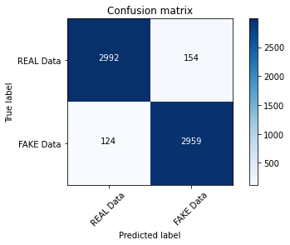

Slide 10
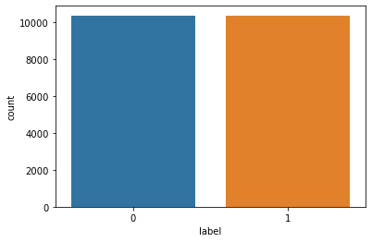
Visualizations

Slide 11
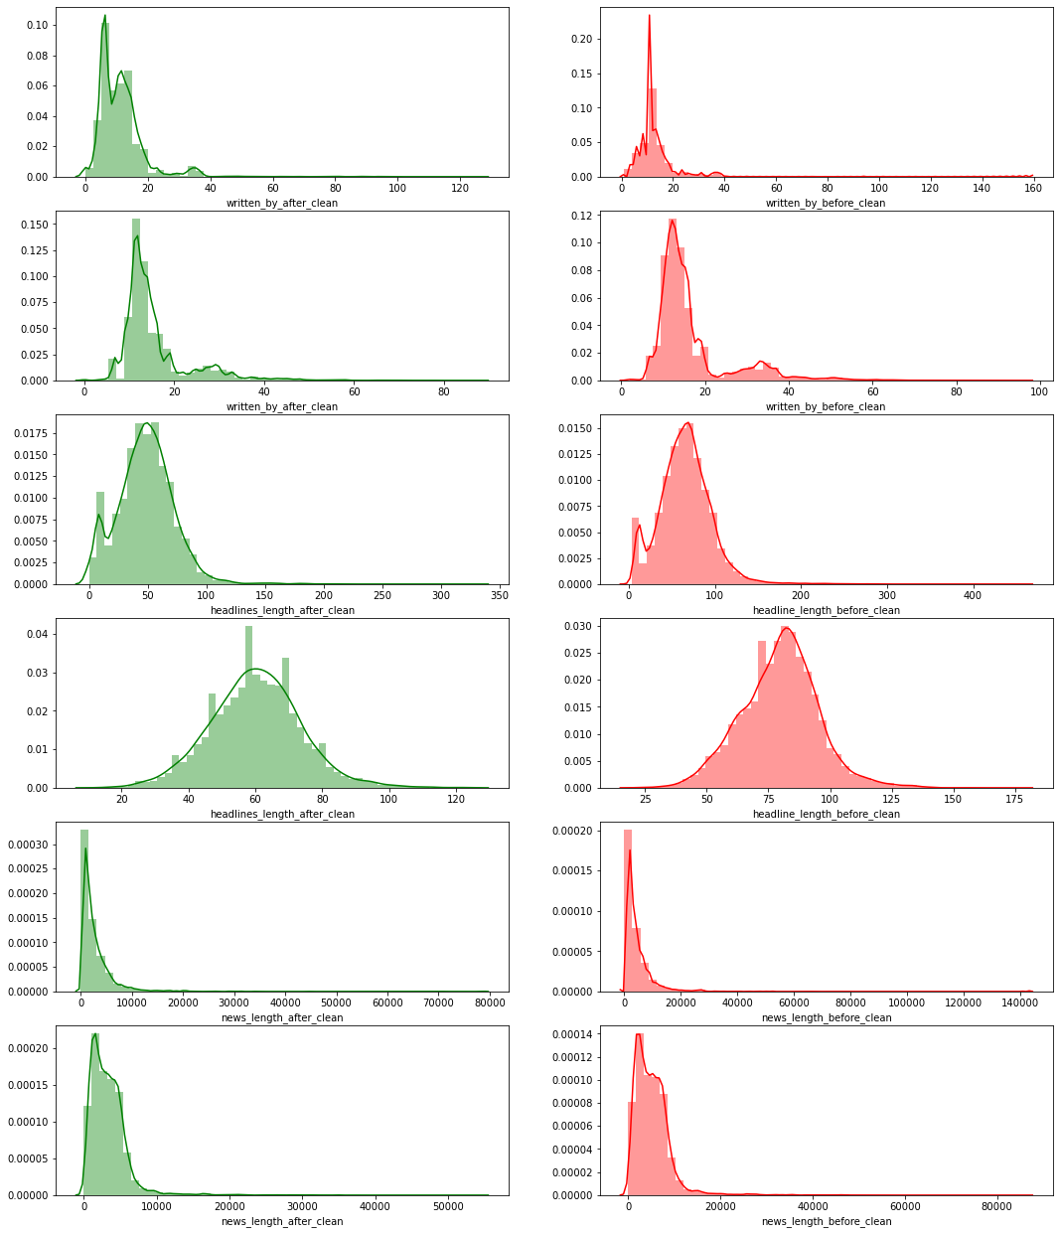

Slide 12
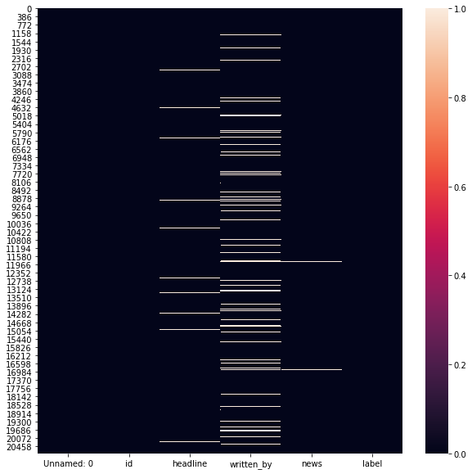

Slide 13
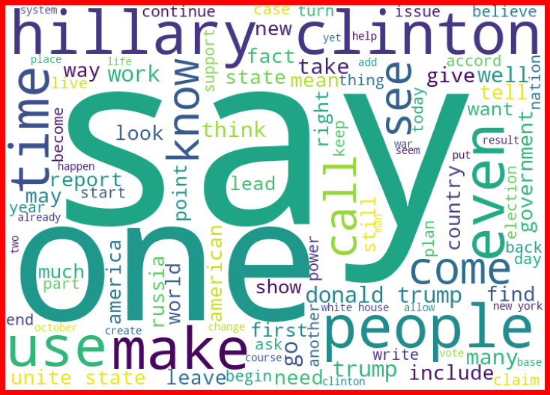

Slide 14
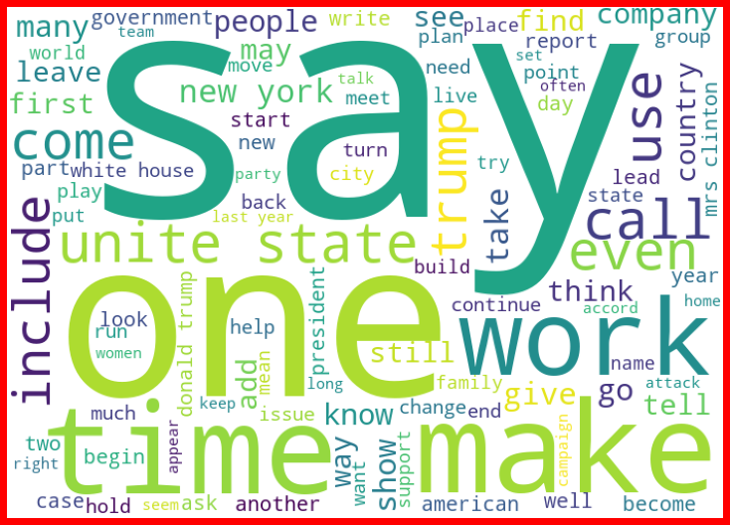

Slide 15
CONCLUSION
Learning Outcomes of the Study in respect of Data Science
I have learn some inbuild function of python at the time of data cleaning. Object columns to Integer are done by using python map function over on lambda function. The main challenging is that to run all model once and get the best model name with best parameters also with a AUC ROC curve plot. This is done by using pipeline. This will helps me to get out from overfitting and underfitting.

